Slide 1
GPP Exam: Zombie AI
Bram Verhulst

Slide 2
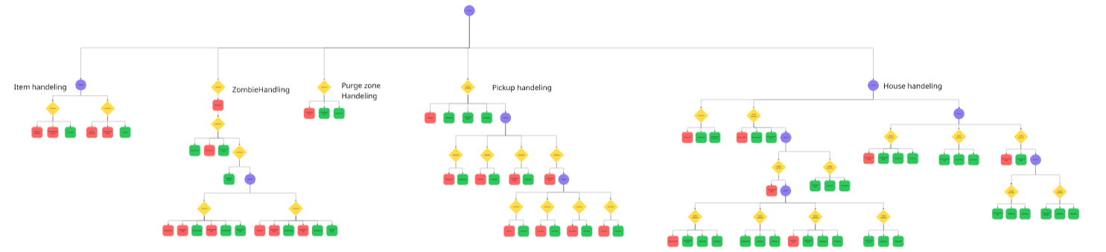
Decision Making

Slide 3
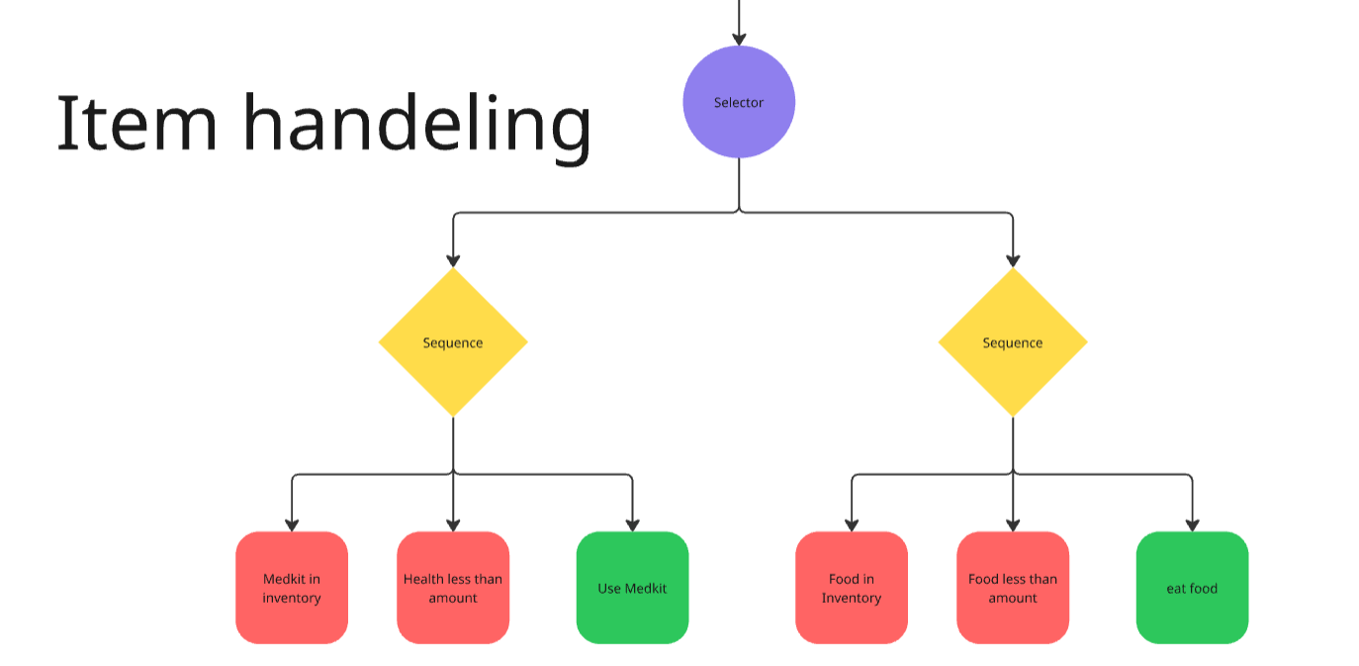
Decision Making
Item handling

Slide 4
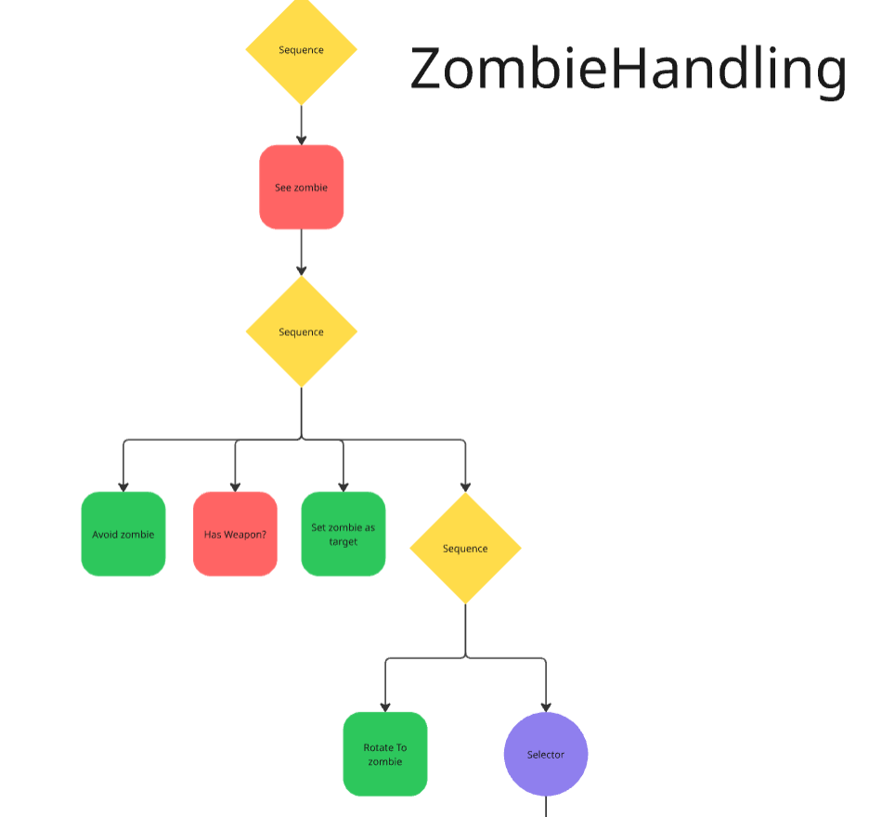
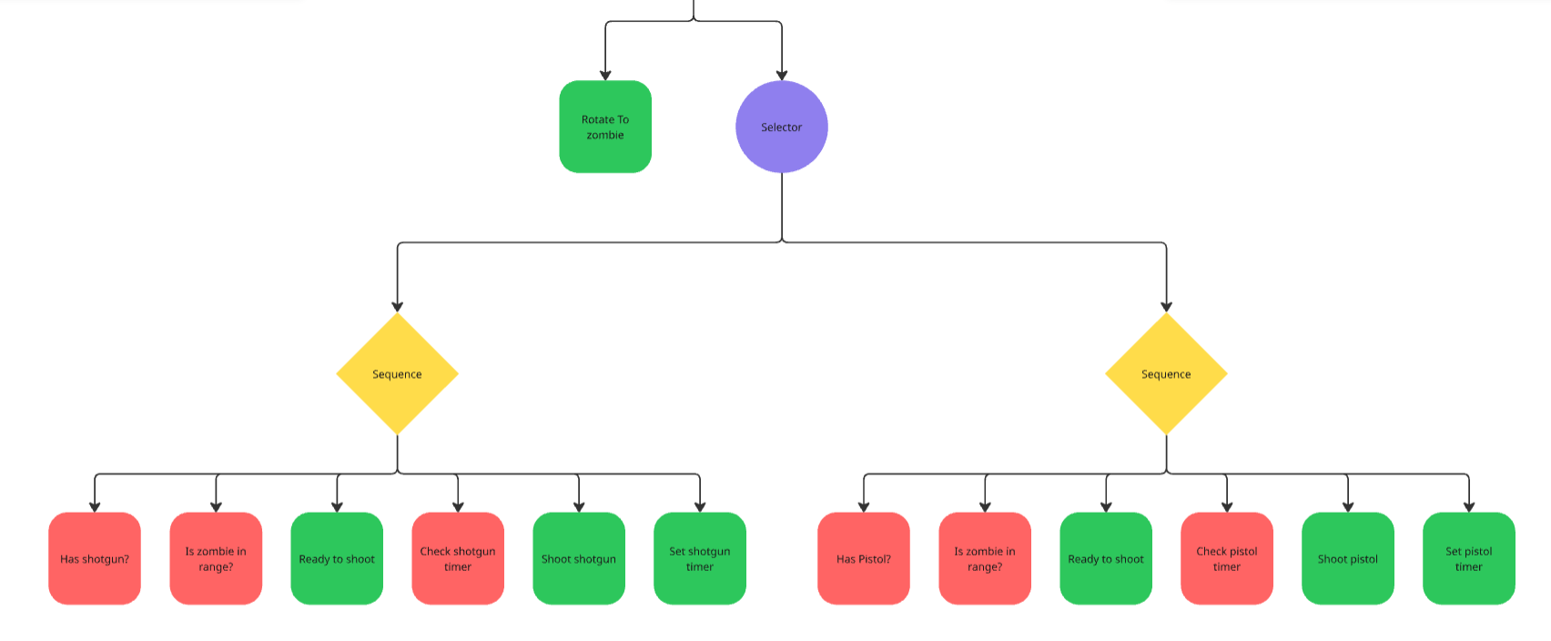
Zombie handling

Slide 5
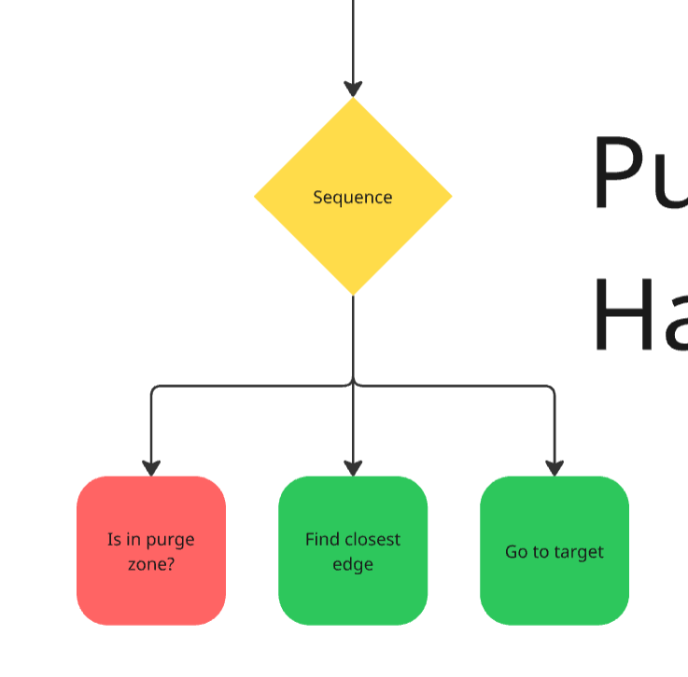
Purgezone handling

Slide 6
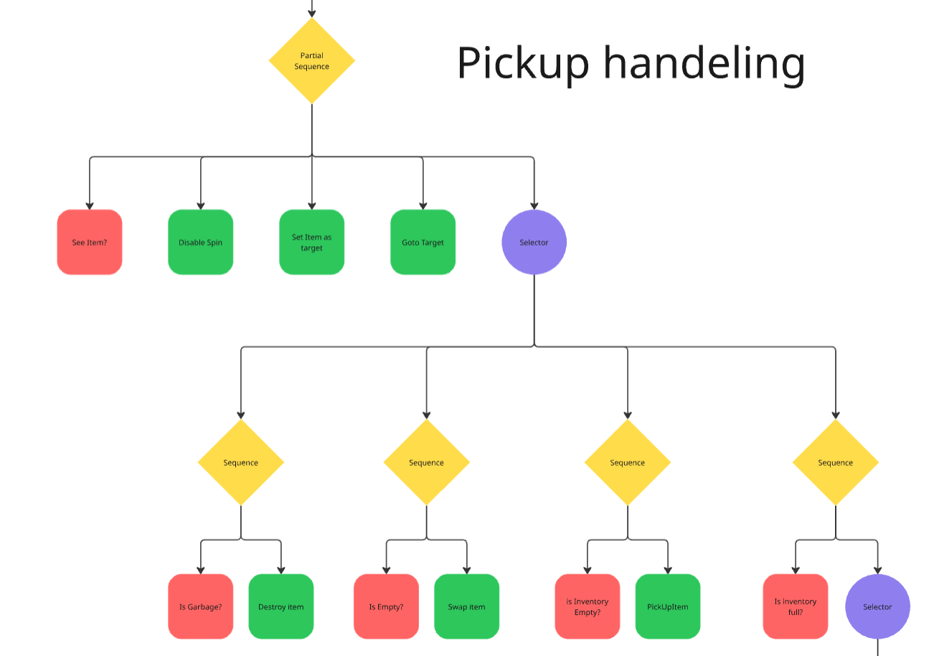
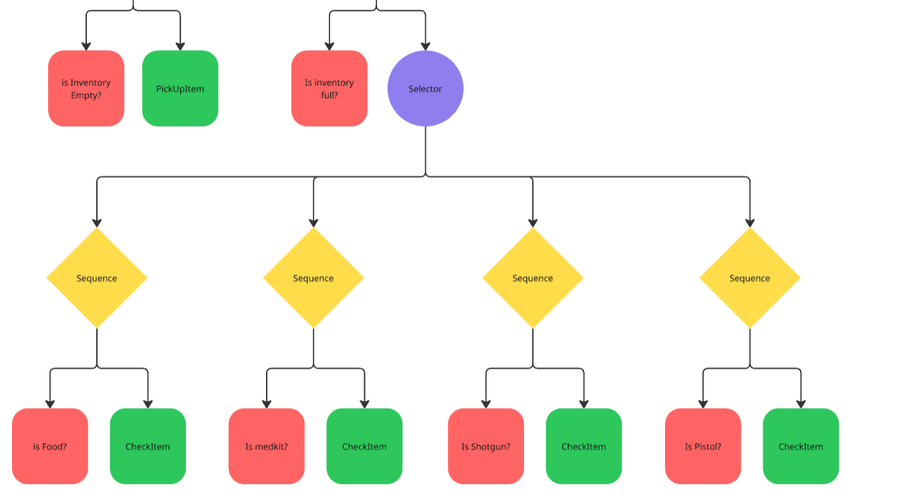
Pickup handling

Slide 7
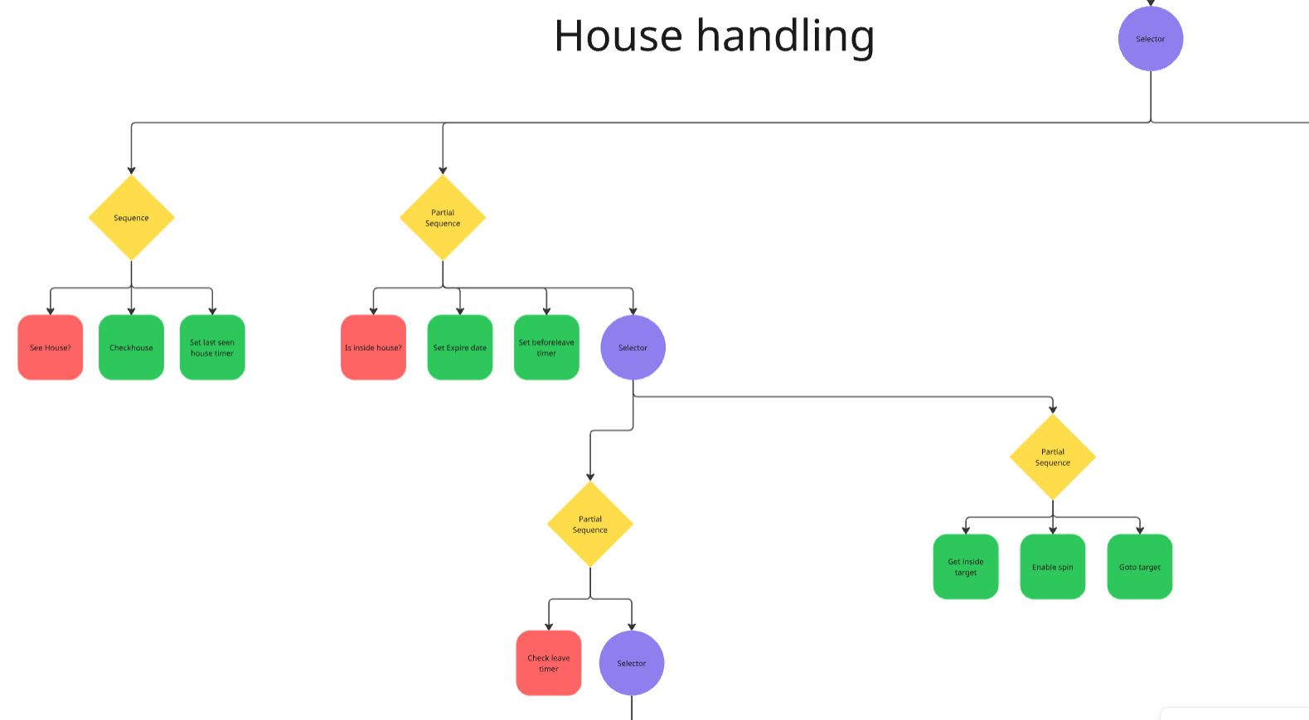
House Handling

Slide 8
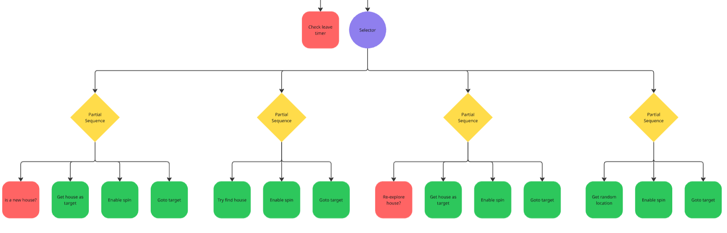
House Handling

Slide 9
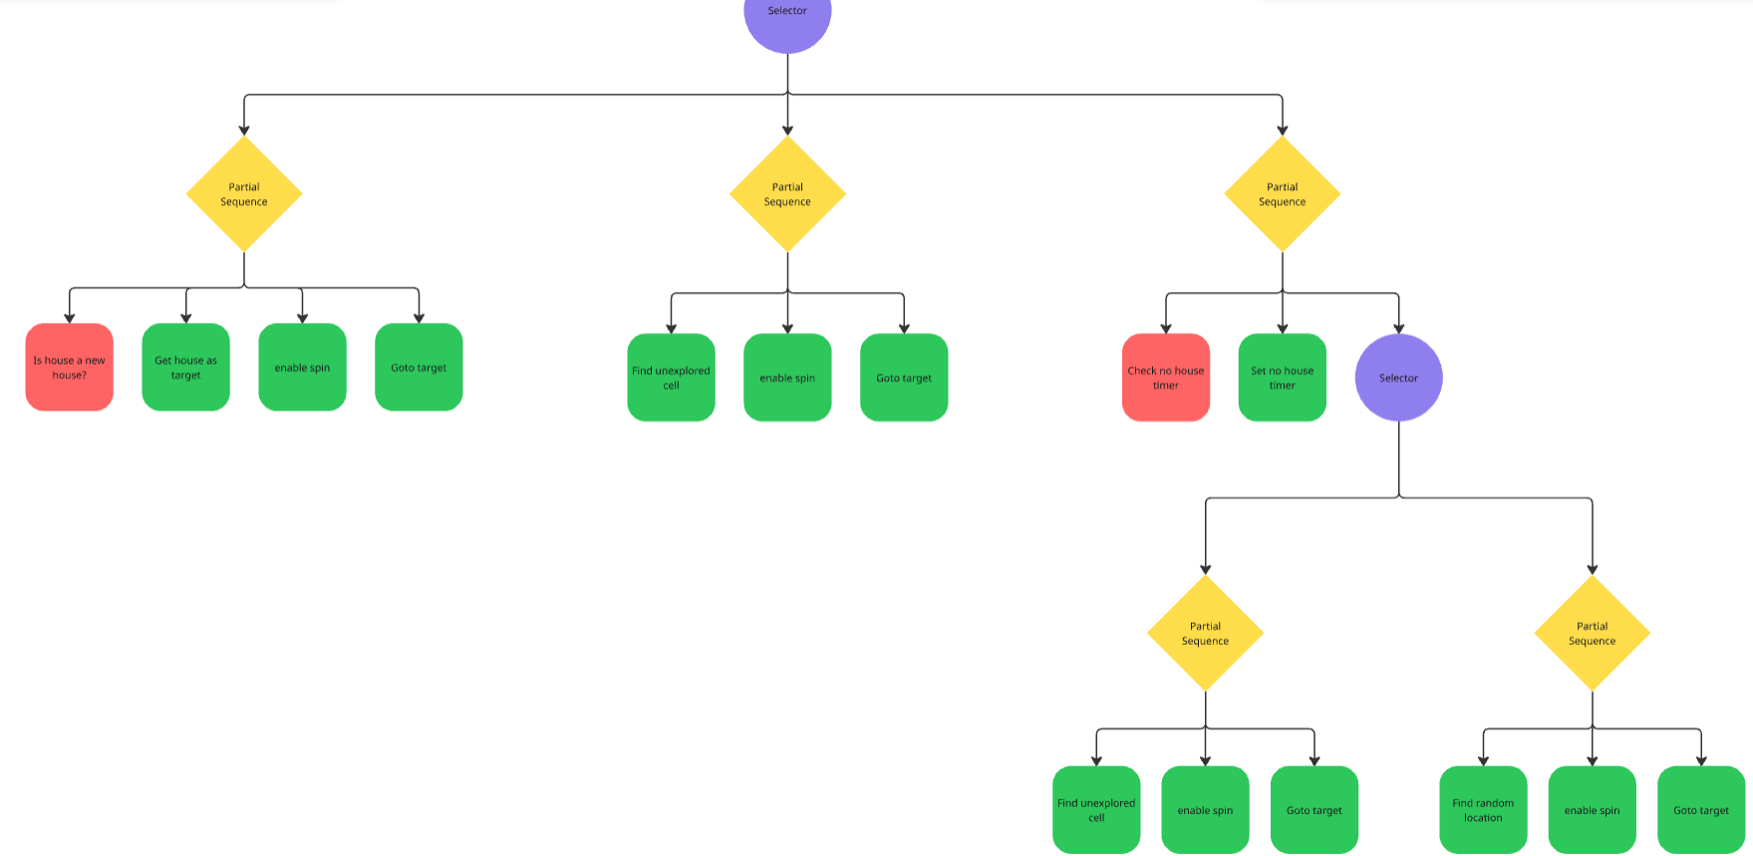
House Handling

Slide 10
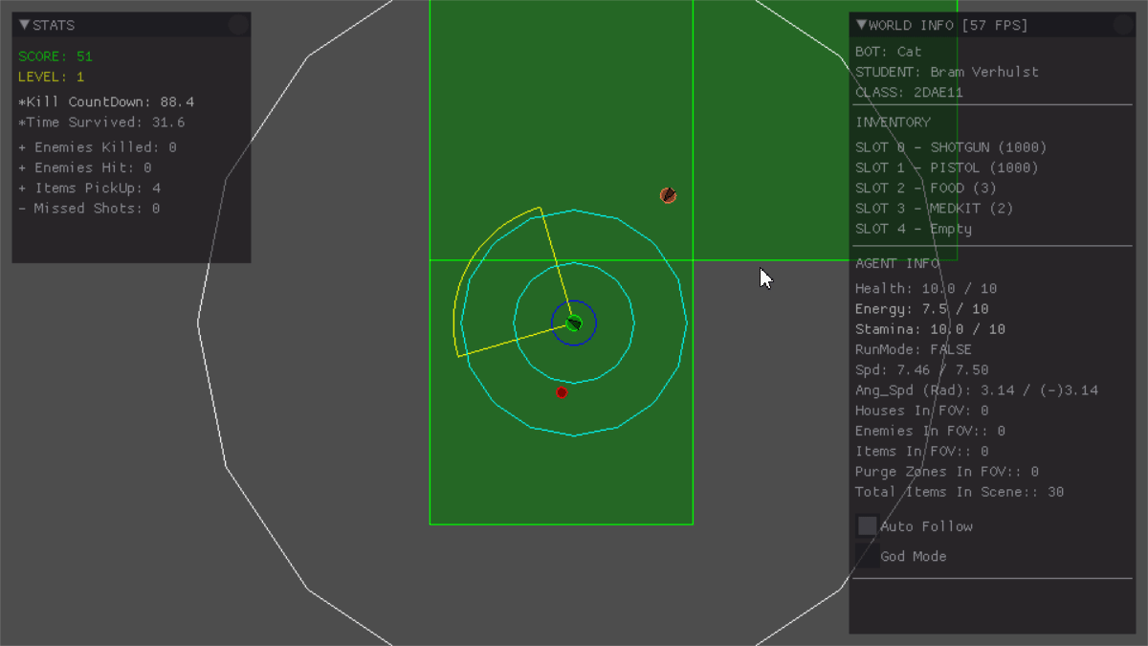
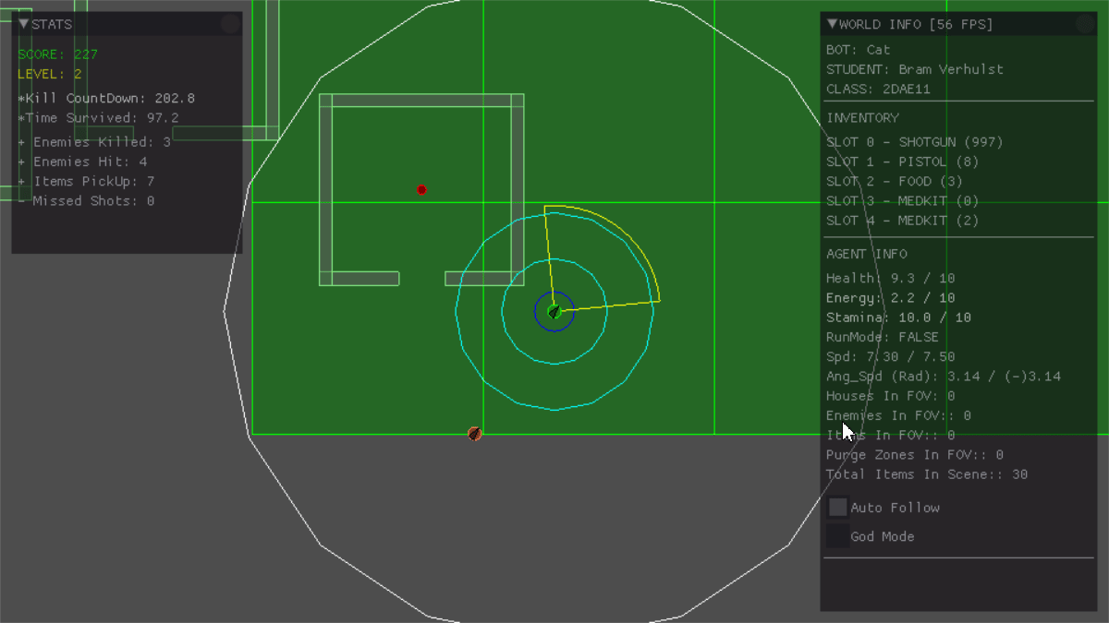
Enemy handling
Faces zombie
Checks distance / Weapons available
Fires gun
Waits a set amount
before shooting again

Slide 11
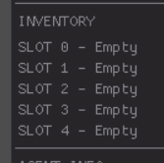
Inventory
Stores next empty slot
Finds item in inventory as needed
Picks item based on amount left

Slide 12
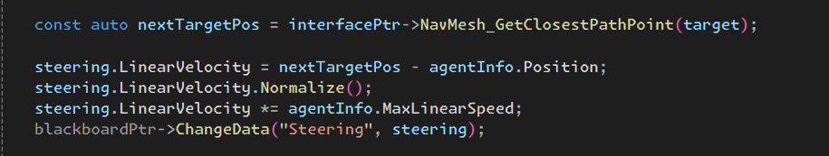
Movement - Steering
Uses target and navmesh

Slide 13
Movement - Exploration
Visit unknown house on sight
Divide world in a grid
Explore close unexplored cells
Priority queue

Slide 14
High Score
Screen shot or list of highest scores

